Slide 1

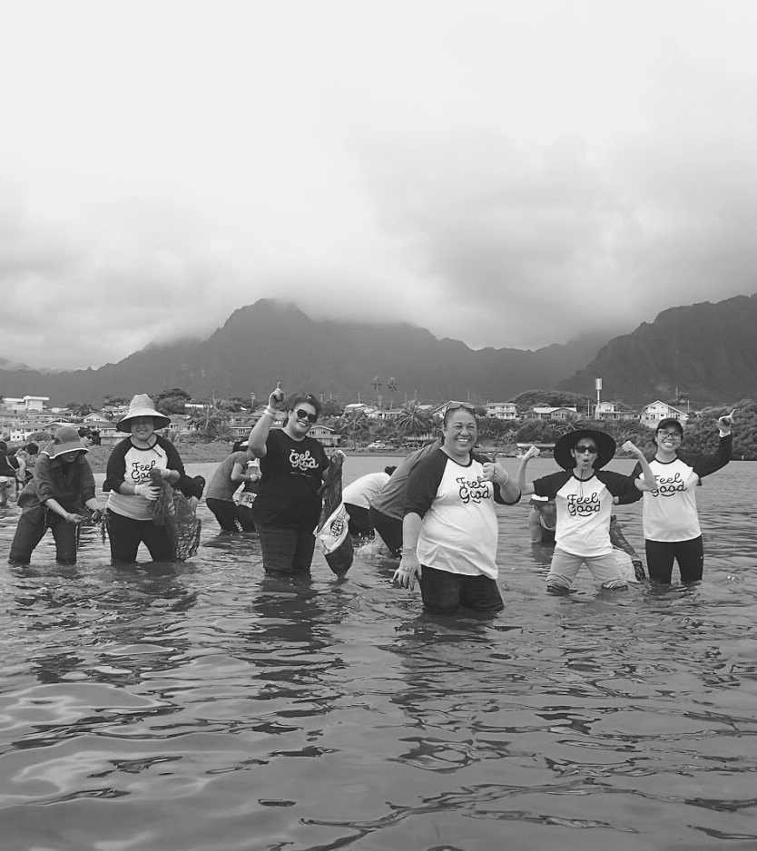

Sustaining our Evidence Based Community Prevention Programming
HHSP Summit
10.25.2023
Cristina Vocalan
Jennifer Valera
Jermy Domingo
Navya Karkada
Notes:
For the Health Care sector breakout, there are a couple of objectives related to MQD (and other health plan) coverage of prevention/management services… specifically ASME, SMBP, MTM, and lactation services (none of which are really being worked on). Before I knew there would be a separate DPP session, I thought you could speak to the process we’ve been going through regarding both the DPP SPA and/or the 1115 waiver for nutrition supports. I wanted the focus to be on the partnerships and stakeholders engaged, how you’re trying to broaden the discussion from just DPP to prevention programs in general, how you gathered input from the FQHC on the services they already offer, etc.
The format of that session will be 3 10-minute presentations (Mia from Queen’s re: HIT and team-based care, Kevin from UHCC re: cancer screening and clinical trials), and hopefully you) that covers:
What progress has been made? See questions above.
How are you addressing health equity?
What are your next steps?
Then there will be time for Q&A. If presenting on MQD doesn’t seem comfortable, maybe something else you’re working on would make more sense? We can discuss more next week.

Slide 2
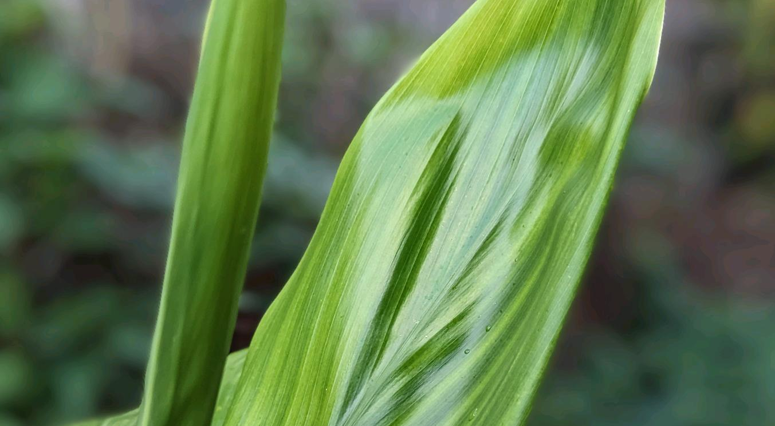
Our Mission
The Hawai‘i Primary Care Association improves the health of communities in need by advocating for, expanding access to, and sustaining high quality health care through our statewide network of Community Health Centers.

Slide 3

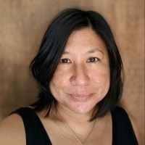
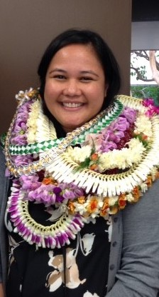
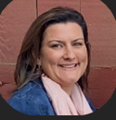
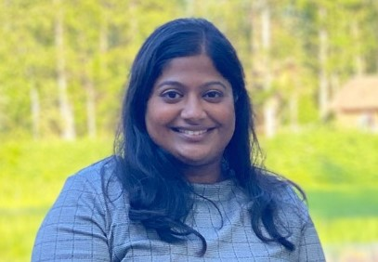
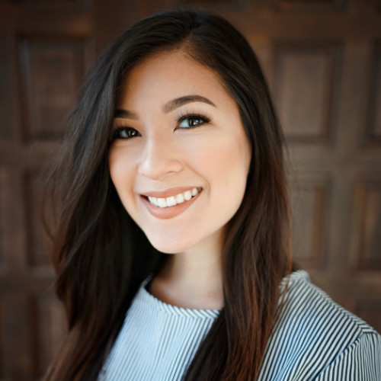
Our Team
Robert Hirokawa, Chief Executive Officer
Kathy Suzuki-Kitagawa, Chief Operating Officer
Tricia Siarot, Chief Financial Officer
Cristina Vocalan
Jermy Domingo
Jennifer Valera
Navya Karkada
Daizha Gomes
cvocalan@hawaiipca.net
jdomingo@hawaiipca.net
jvalera@hawaiipca.net
nkarkada@hawaiipca.net
dgomes@hawaiipca.net
Chief Strategy Officer
Health Equity Director
Senior Program Analyst
Population Health Manager
Prevention Intern
Notes:
JD

Slide 4

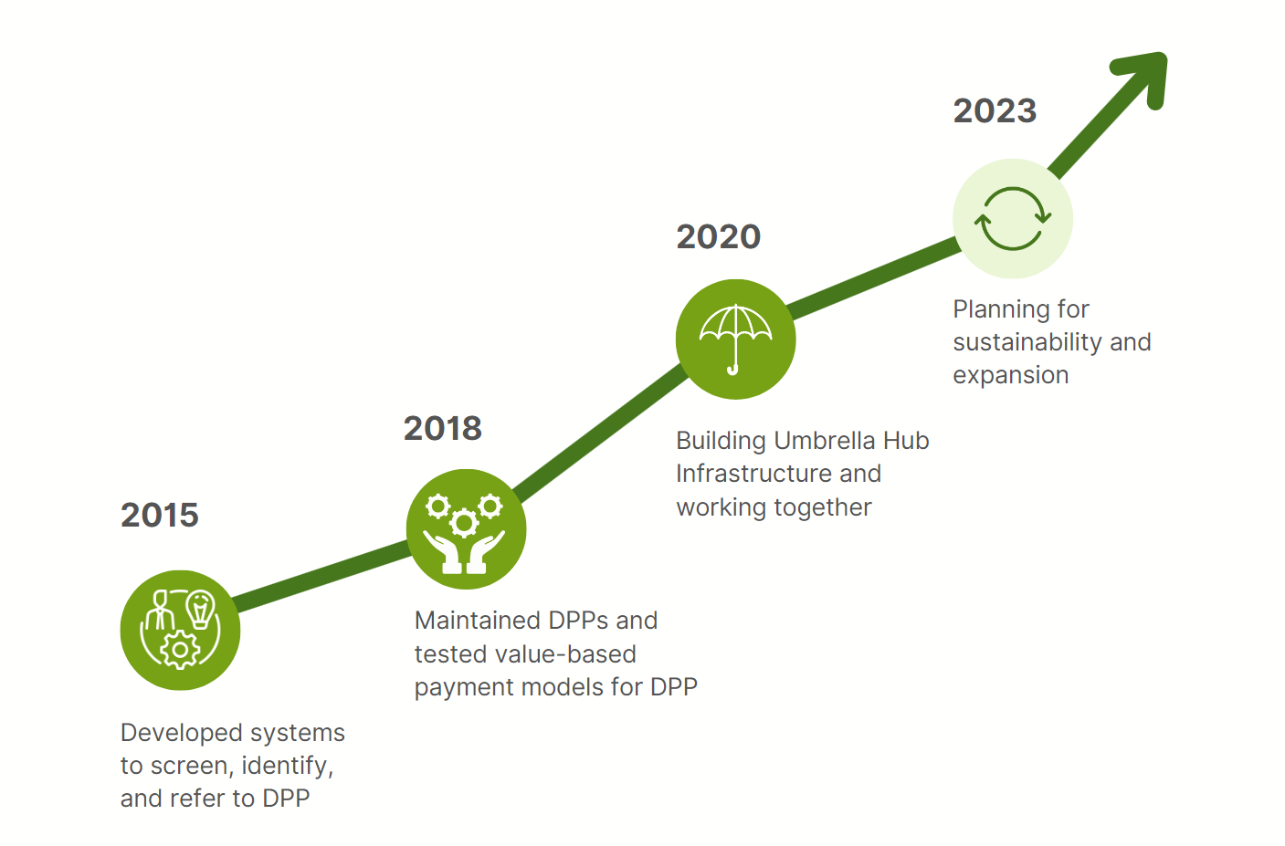
HPCA and Hawaii FQHCs National Diabetes Prevention Program Journey
6 NDPP
5 Full Recognition
4 NDPP
3 Full Recognition
8 NDPP
2 Full Recognition

Slide 5
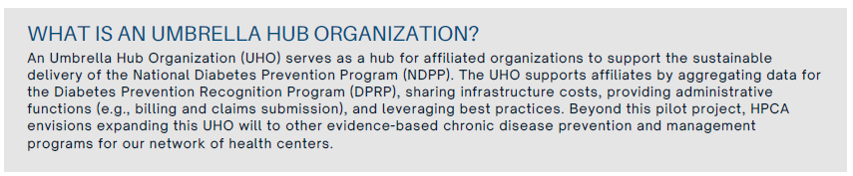
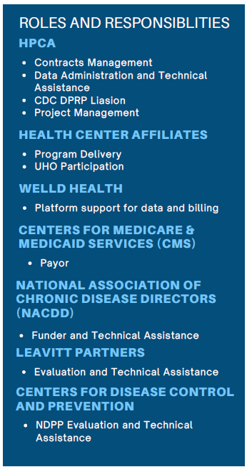
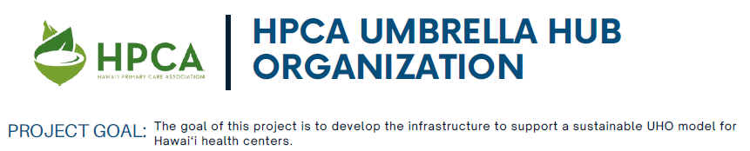
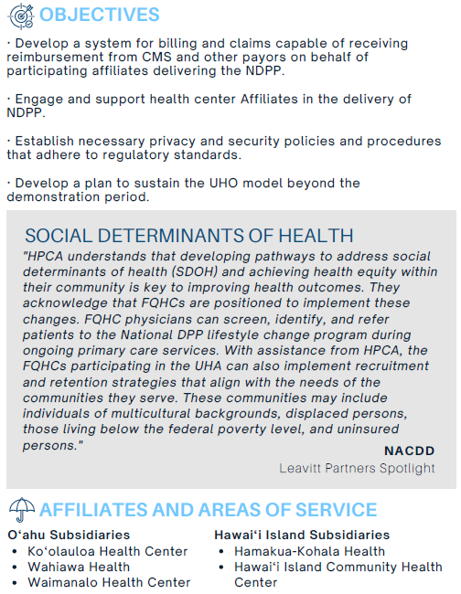

HPCA Umbrella Hub Organization Development

Slide 6
Our HPCA Umbrella Hub Journey
2020
UHO Demo Opportunity
2021
Continued UHO Development
2022
Board Strategic Planning
VBC Learning Collaborative
2023
Prevention Network for sustainability
LLC Development
Initiated Sustainability Discussions: DOH & Prevention SPA with MQD
Explore Community Care Hub concept

Slide 7

Mahalo
Cristina Vocalan cvocalan@hawaiipca.net

